Slide 1
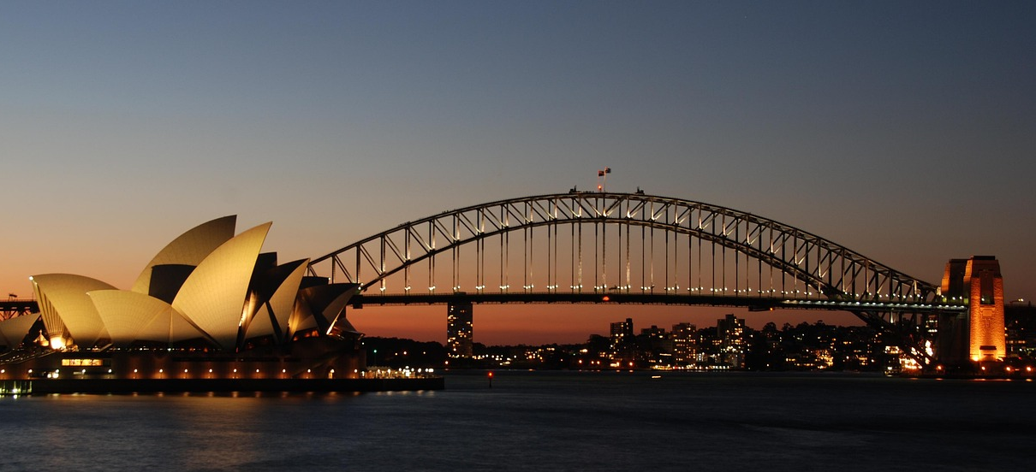
25 – 27 JUNE 2025
MECURE SYDNEY
GADIGAL
AUSTRALIA

Slide 2
Session Title
Title
Speaker

